Slide 1

Introduction to Neuroscience Futures

Slide 2
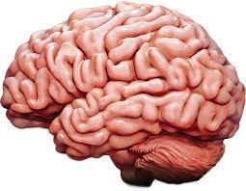
Neuroscience futures…
Why study the brain?
Source of all hopes, dreams, memories
How does the brain process stimuli to tailor behavioural responses?
What happens when brain function is altered?
How can we study such complex processes in the lab?

Slide 3
Dr Will Norton
Associate Professor of Animal Biology at the University of Leicester; Honorary Professor at ELTE
BSc (Neuroscience) at University of Sheffield
Phd (Developmental Neuroscience) at University College London
Postodoctoral Research EMBL Heidelberg, Helmholtz Centre Munich, CNRS, Gif/Yvette
Worked in Leicester since 2012

Slide 4

Four current research topics:
Hacking the brain
> Techniques to manipulate brain function and measure the consequences
From neural circuits to behaviour
> How to identify and manipulate neural circuits; hunting as an example
Neuroscience of social behaviour
> Types of social behaviour; the social brain; effect of isolation on behaviour
Animal models of complex diseases
> How can we model complex diseases such as psychiatric disorders in fish?

Slide 5

Structure of each topic
Each topic is split over two weeks, ~2h per week
Week 1: Self-guided study in own time
Listen to two short pre-recorded lectures, ~ 20 min each
Working in groups, prepare a short presentation of a pre-selected paper
Week 2: Two hour live sessions, 14:30 – 16:30 (13:30 in UK)
First hour – live expert lecture
Second hour – presentations in groups
Material will be presented via Teams, with the possibility of a face-face
session in November

Slide 6
Each topic is contained in its own folder
The Teams site contains a folder with a copy of my slides, recorded lectures, background
reading etc
Each folder is used for the two weeks covered by a topic…
Feel free to add information in yourselves to build a communal resource!

Slide 7

Each topic folder also contains suggested reading
Some papers will be used for group presentations (more about this later!)
Others provide (optional) background reading for general interest and talk preparation
Other sources of information: PubMed, Web of Science, Google Scholar, Wikipedia (?)
Podcasts, Youtube videos, TED talks….

Slide 8
Module assessment
Each topic will end with group presentations of a paper
Each group presentation will be awarded a grade: four presentations, each makes
25% of final mark
Presentations will be marked based upon information content, clarity of slides
Individual mark for presentation style
Each talk should be max. 10 min with 5 min for questions
Please email slides to me (wnorton@staff.elte.hu) before the presentation day
A marking scheme is available on Teams site

Slide 9
Presentation groups
Group 1
Group 2
Group 3

Slide 10
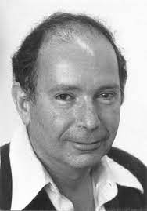
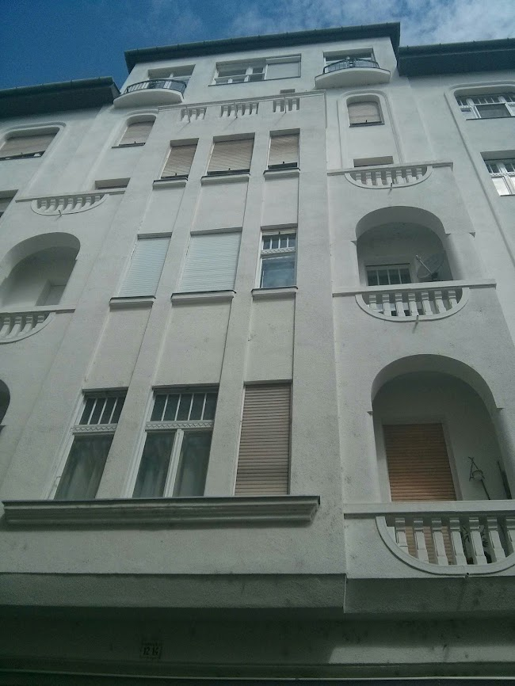
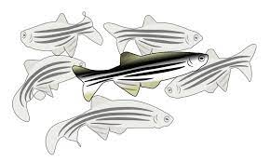
Zebrafish as a model organism
George Streisinger – Budapest and Oregon!
First to establish zebrafish as a model organism
ZF are easy to keep in the lab
Small, develop quickly, transparent at larval stages
Genetically manipulatable

Slide 11
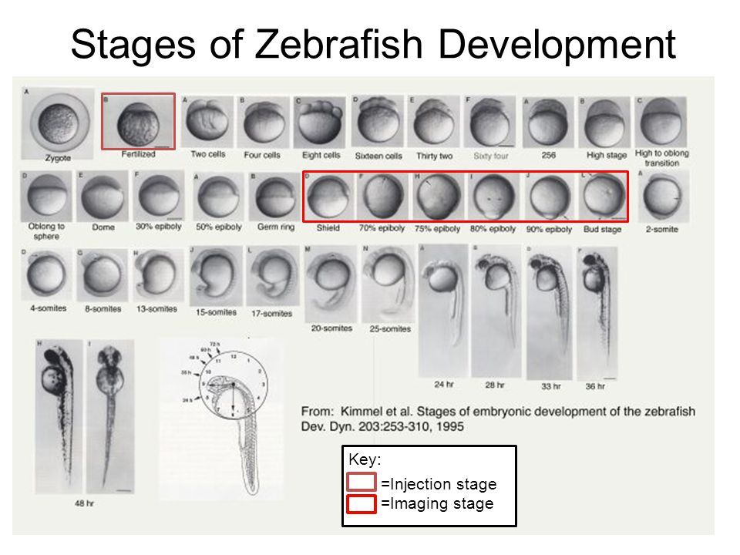

Zebrafish (Danio rerio)

Slide 12
Gene expression: in situ hybridisation
In situ hybridisation is a technique to visualise gene expression in a tissue
An mRNA probe is made by copying a DNA template – the gene of interest (reverse
transcription)
The mRNA probe is labelled with an antigen (e.g. digoxygenin). It hybridises to the gene of
interest within the tissue
Antibody labelling is used to reveal where the probe binds – fluorescent or colourimetric
detection

Slide 13
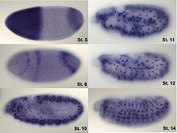
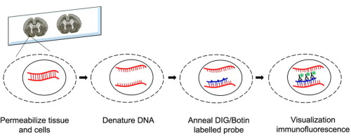
Gene expression: in situ hybridisation
RNA probes that are complementary to the gene of interest are synthesised
Probes are annealed to the tissue and then visualised (whole mount / sections)

Slide 14
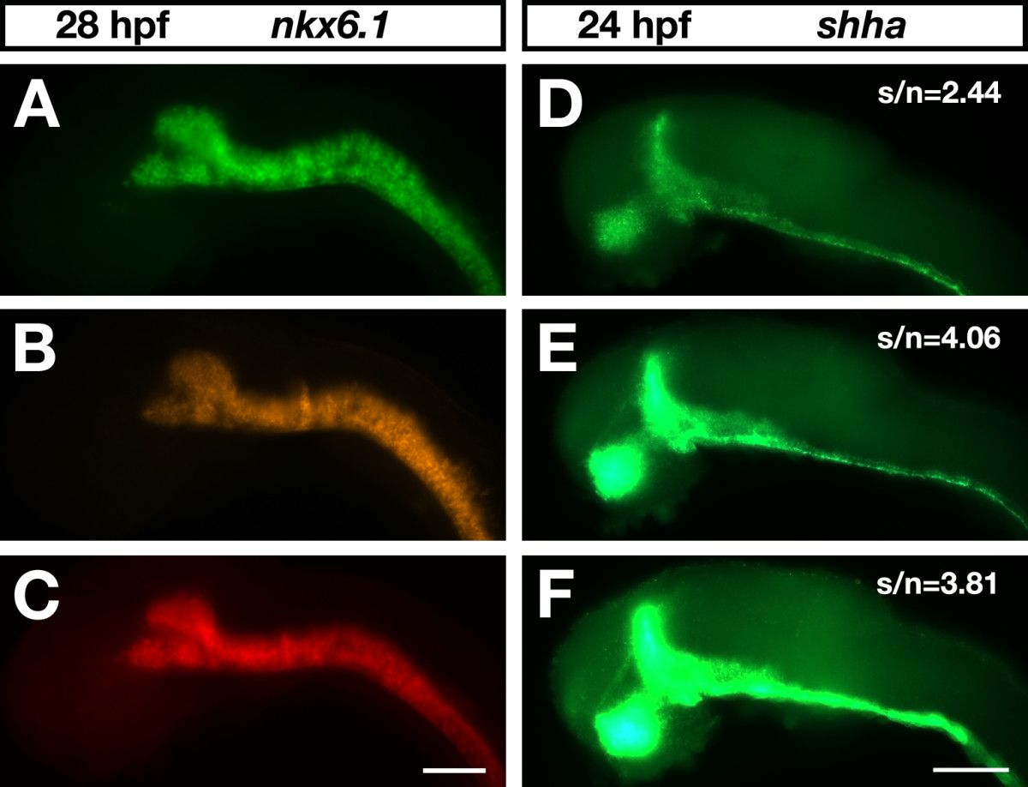
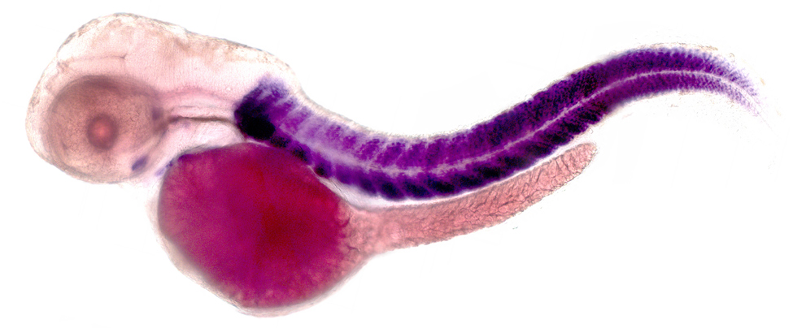
Gene expression: in situ hybridisation
Several genes can be studied using different colours
Lacks cellular resolution; works better for highly expressed genes
Images from Lauter et al., 2011; and UMASS, Amherst

Slide 15
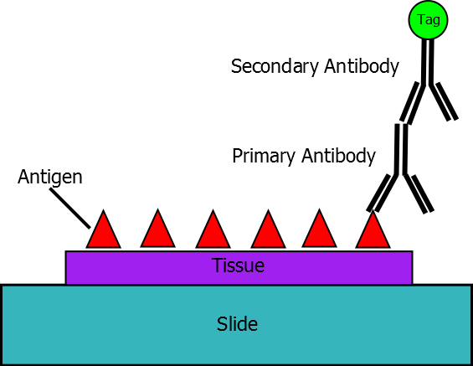
Protein localisation: immunohistochemistry
Antibody labelling can be used to localise proteins in tissues
Primary antibody binds target protein and a secondary antibody is used to
visualise it
Antibodies can be difficult to make; technique is more
expensive than in situ hybridisation
Labelling can give cellular resolution
Image from Wikipedia

Slide 16
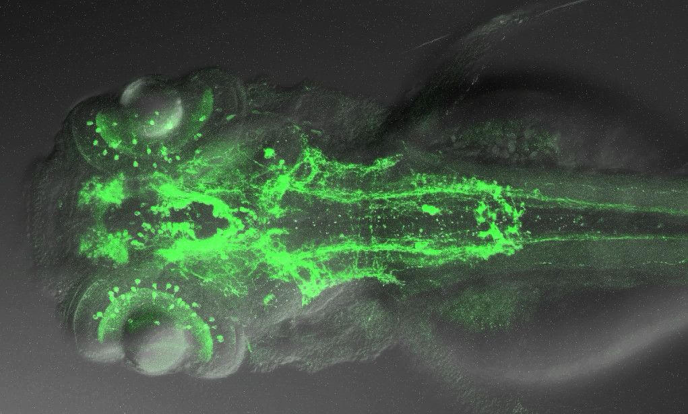
Immunohistochemistry
Zebrafish monoaminergic neurons (image credit: UCL)

Slide 17
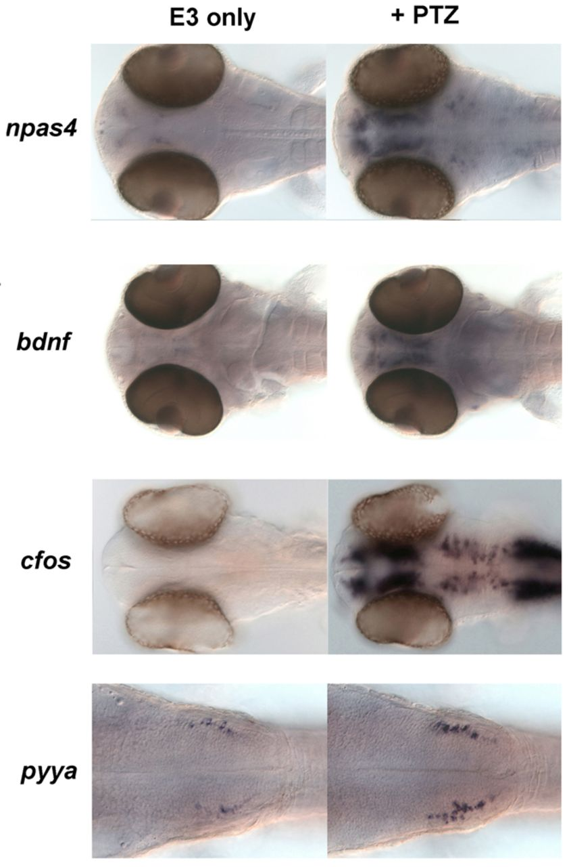
Immunohistochemistry: neural circuit activity
Some proteins are the product of immediate early genes
(e.g. cfos)
IEGs are upregulated by neural activity – can be used to
map the response of the brain to behaviour or drugs
Compare animal with and without experience of behaviour
No temporal information available
Background noise / specificity?
Pentylenetetrazole (convulsant)

Slide 18
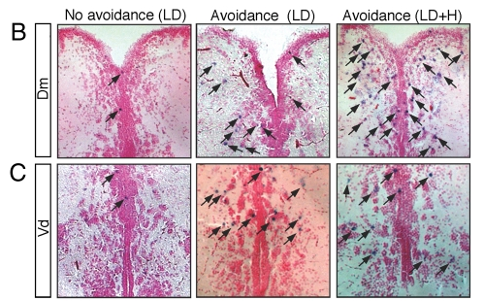
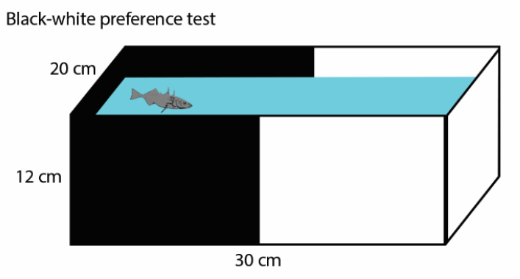
Immunohistochemistry: neural circuit activity
Compare Cfos in the brain of fish that do- or do
not avoid the dark compartment of a tank
Lau et al., 2011

Slide 19
Transgenesis: stable visualisation of proteins
Transgenic lines contain an exogenous DNA sequence – the transgene
Requires appropriate promoter and enhancer elements to be cloned
Various reporters can be used: fluorescent proteins; optogenetic tools; genetic
drivers / amplifiers
Transposable
elements
Transposable
elements
Tissue specific promoter
Transgenic reporter
Stop
signal
Transposons can be used to insert the construct into the genome

Slide 20
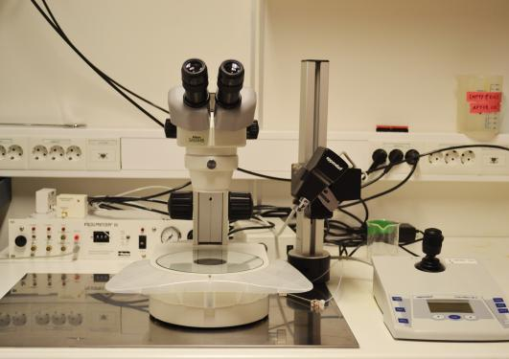
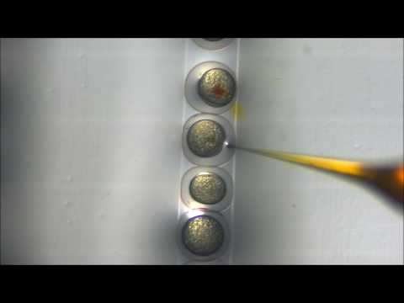
Transgenes can be introduced into animals by microinjection
Needle contains DNA
solution and coloured dye
Animals are grown to the required stage for analysis
Notes:
Constructs can also be feed in some species (RNAi, flies / worms)

Slide 21
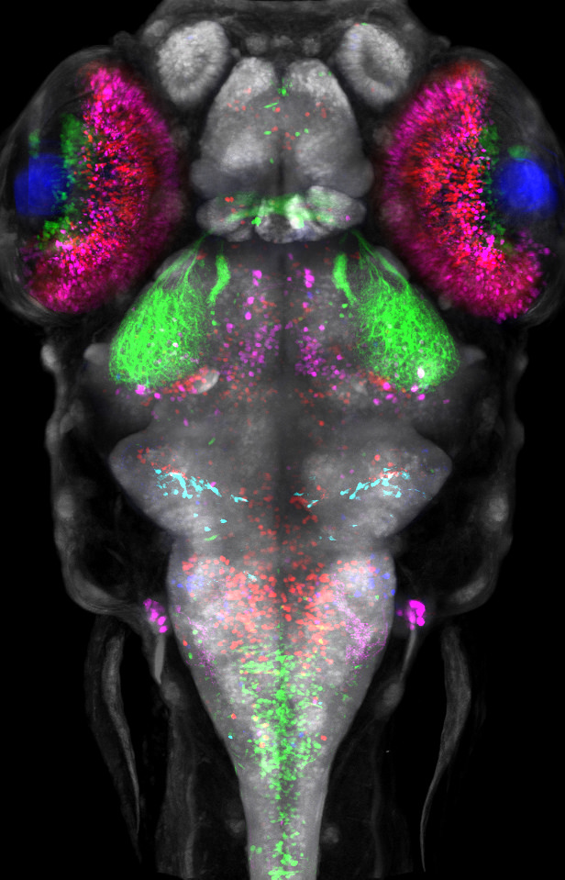
Transgenesis: stable visualisation of proteins
Label multiple cell types at the same time
Movies to show organs growing in real time

Slide 22
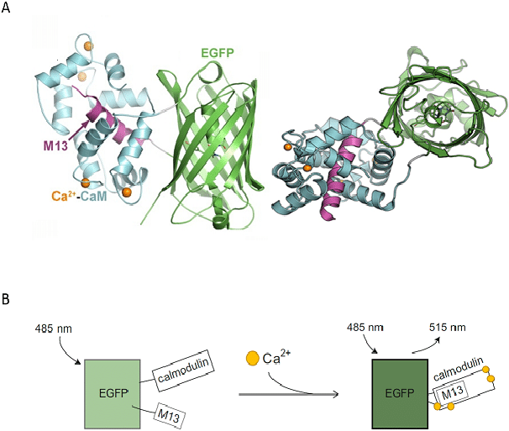
Live imaging with calcium indicators
Genetically-encoded calcium indicators (GECI)
- fluoresce when calcium binds
Since neural activation is Ca dependent,
can be used as a readout of activity

Slide 23

Live imaging with calcium indicators
Genetically-encoded calcium indicators (GECI)
Can be used to visualise neural activity in real time
High resolution – limit is ability of microscope to penetrate tissue

Slide 24
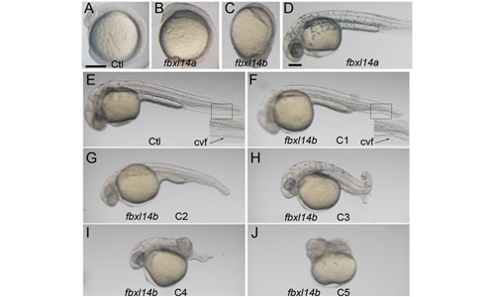
Transgenesis can be used to over-express genes
Gain-of-function experiments in animals
Clone the full length sequence of the
gene of interest under control of a
tissue-specific promoter
Inject into single-cell zebrafish embryos and grow to
Grow to required stage
Analyse phenotype
Photo credit: Yiping Li

Slide 25
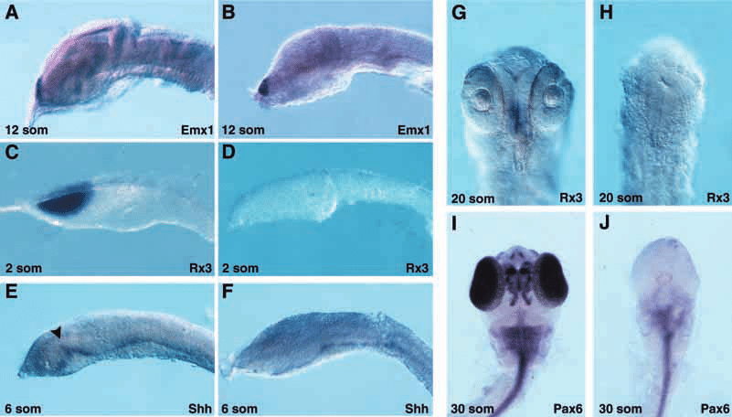
Over-expression can be tissue specific
Overexpression of the engrailed gene reduces zebrafish forebrain development
Ristoratore et al., 1999

Slide 26
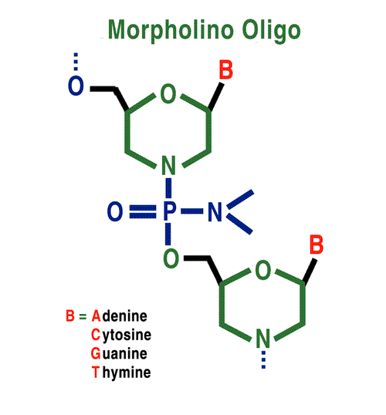
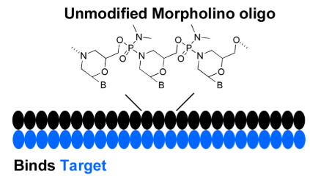
Transient knock-down of genes by microinjection
Morpholino oligonucleotides or anti-sense RNA sequences can be injected to
knock-down gene function
Morpholinos are short antisense oligonucleotides that inhibit translation (no
protein formed). Active for about 5 days before gene function recovers
Notes:
RNAi does not work in all animals

Slide 27
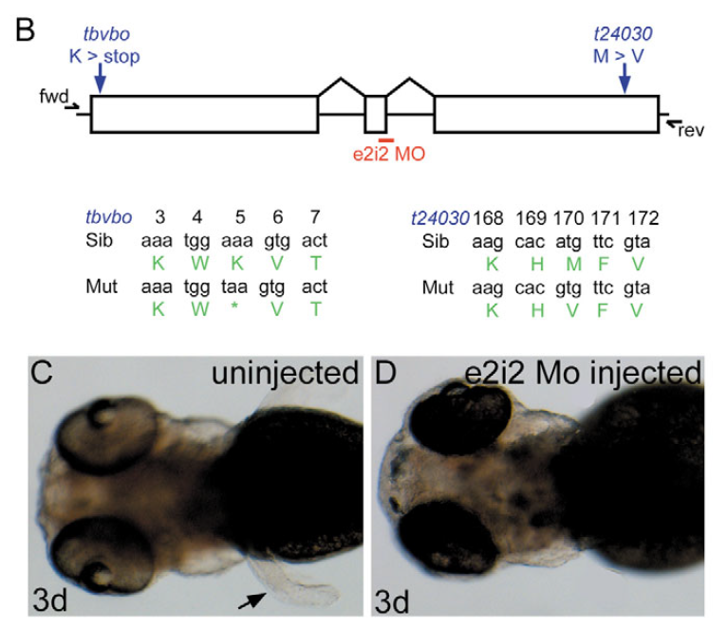
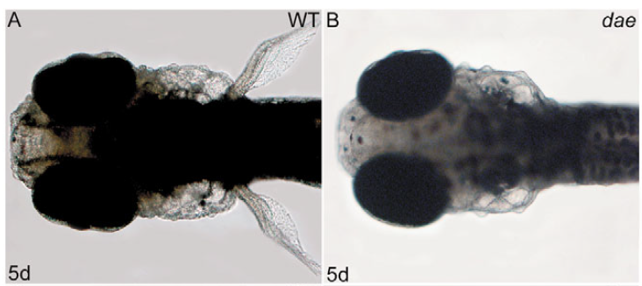
Transient knock-down of genes by morpholino
Morpholinos can be designed to:
Inhibit the initiation codon (ATg)
Inhibit a splice donor or acceptor
fgf10a mutant line
fgf10a splice morpholino injection
Norton et al., 2005

Slide 28
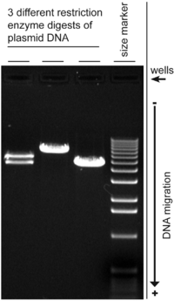
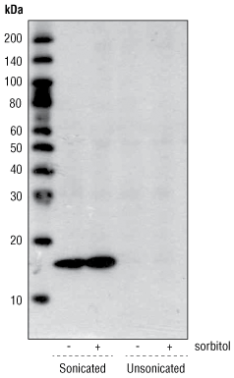
Transient knock-down of genes by morpholino
What about specificity?
Knock-down of genes can be quantified by:
Western blot qPCR
No MO
MO
Look for reduction
of protein levels
Look for changes
to gene splicing

Slide 29
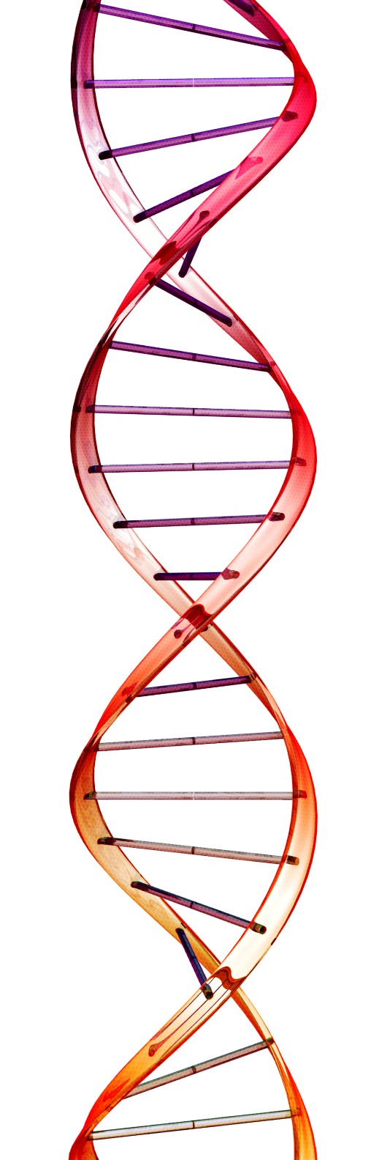
Transient knock-down of genes by morpholino
Morpholinos are: Cheap
Fast to design and inject
Transiently knock-down gene function
Can be non-specific (“off-target effect”)
May cause uncontrolled cell death
Appropriate controls: Design two independent morpholinos
Rescue by co-injecting cDNA
Compare to a stable mutant line

Slide 30
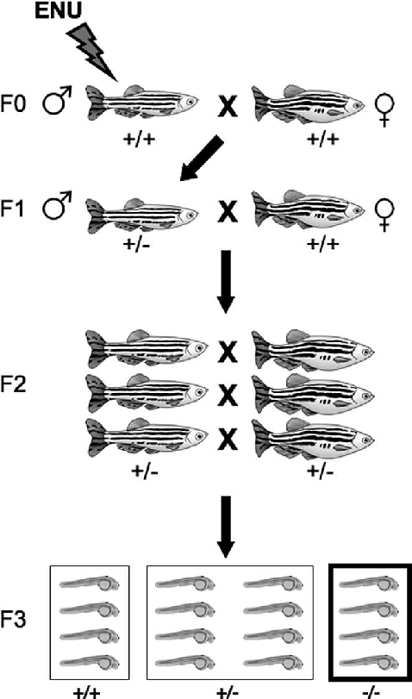
Stable knock-out: chemical mutagenesis
Chemical can be used to mutate genes: e.g.
ethylnitrosourea (ENU)
Random mutagenesis of base-pairs
Can be used to find novel genes important
for a behaviour / process
Lee et al., 2012

Slide 31
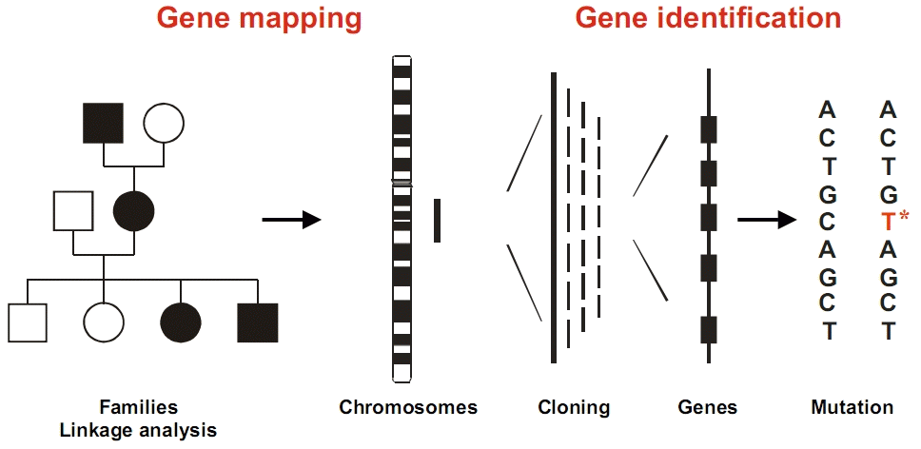
Stable knock-out: chemical mutagenesis
Challenge is to identify the position of the mutation:
Positional cloning
Whole genome sequencing
Linkage can be used to “walk along” the chromosome and identify mutations

Slide 32

Genome engineering
The insertion of deletion of specific sequences in the genome. Targeted – does not rely
on random mutagenesis. Can be used to make stable mutant lines
Techniques include Zinc Finger Nucleases; TALENS (Transcription activator-like effector
nucleases); and CRISPR/Cas9 (clustered regularly interspaced short palindromic repeats)
Ability to mutate nearly any gene (although loci that cannot be mutated do exist)
Notes:
So cannot identify novel genes – limited to our prior knowledge

Slide 33
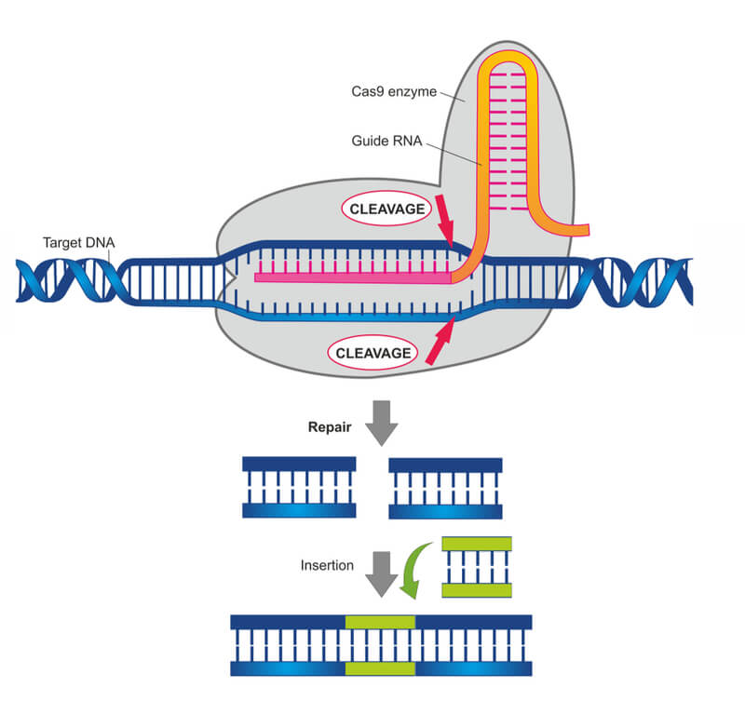
Genome engineering
Design a short guide RNA sequence. Co-inject
with Cas9 protein: Cas9 acts like molecular
scissors to cut the DNA sequence
The body’s natural repair mechanism –
“non-homologous end joining” repairs the cut
In some cases a mistake is made introducing a
mutation
Image from LabBiotech.eu

Slide 34
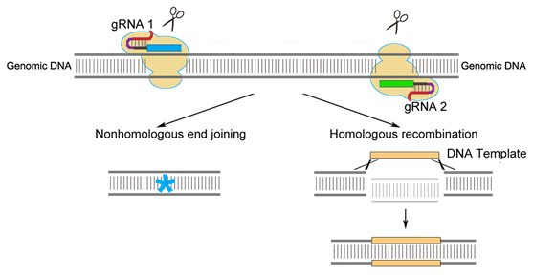
Genome engineering – knock in technology
DNA template with homology arms
Simultaneous inclusion of a novel DNA template can be used to introduce new
sequences: “Homologous Recombination”, “Knock-in”

Slide 35
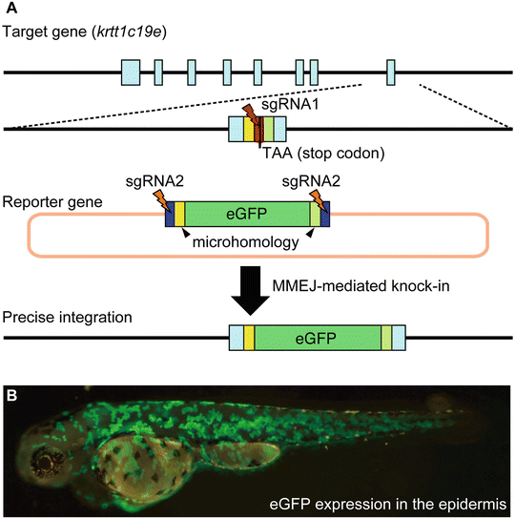
Genome engineering – knocking in genes
Example: knock-in of GPF to
krttc193 locus
Homology arms needed to insert
transgenic cassette
Image from Kawahara, 2017

Slide 36
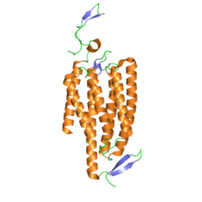
Optogenetics – altering neural activity
Based upon transgenic expression of ion channels that are activated by light:
Channelrhodopsin – activated by blue light. When opened, Ca++ ions
enter neurons (increase firing)
Halorhodopsin – activated by yellow light. When opened, Cl- ions
enter neurons (decrease firing)
Permit temporal and spatial control of neural activity in intact brain
Channelrhodopsin

Slide 37
Optogenetics – Channelrhodopsin
Light can be used to dissect the function of neural
circuits in intact brains
Wenchao Gu

Slide 38
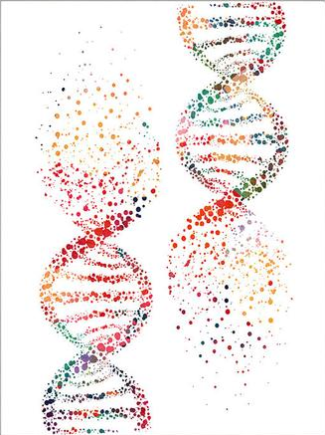
Summary – zebrafish as a model organism
Zebrafish are small, easy to breed and can be manipulated genetically
Standard behaviour tests have been established
Gene expression can be measured by RNAseq, in situ hybridisation
Immunohistochemistry can be used to localise proteins
Transgenesis can locate proteins or manipulate their function
Genes can be over-expressed or knocked out and the impact upon
the brain measured
Optogenetics uses light to investigate the function of neural circuits
in the intact brain

Slide 39
Four topics
Hacking the brain
Self-guided study 17.09.21
Live session 24.09.21 2-4 pm
From neural circuits to behaviour
Self-guided study 01.10.21
Live session 08.10.21 2-4 pm
Neuroscience of social behaviour
Self-guided study 15.10.21
Live session 22.10.21 2-4 pm
Animal models of complex diseases
Self-guided study 29.10.21
Live session 05.11.21 2-4 pm (face to face?)

Slide 40

Questions?

